Slide 1
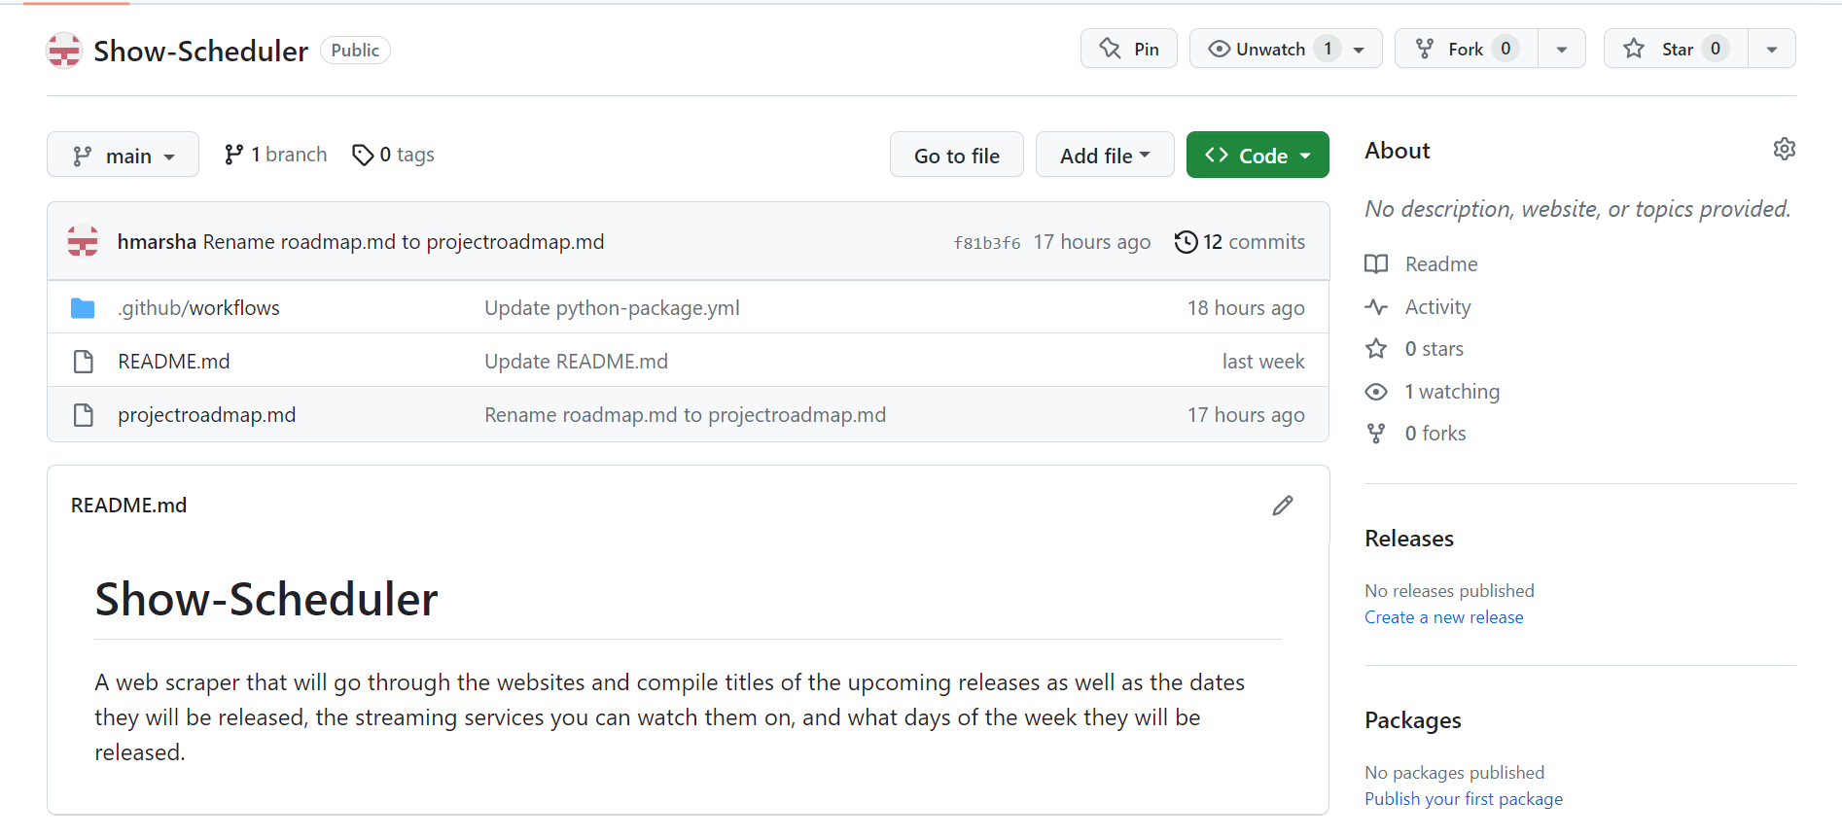
SHOW-SCHEDULER
Presented by:
Hannah Marsha

